Slide 1
HTML Fundamentals
9/4/2021

Slide 2
半岛中文学校 HTML Fundamentals
What is HTML
HTML is the standard markup language for creating Web pages.
HTML stands for Hyper Text Markup Language
HTML describes the structure of a Web page
HTML consists of a series of elements
HTML elements tell the browser how to display the content
HTML elements are represented by tags
HTML tags label pieces of content such as "heading", "paragraph", "table", and so on
Browsers do not display the HTML tags, but use them to render the content of the page

Slide 3
半岛中文学校 HTML Fundamentals
A Simple HTML Document
<!DOCTYPE html> <html> <head> <title>Page Title</title> </head> <body> <h1>My First Heading</h1> <p>My first paragraph.</p> </body> </html>

Slide 4
半岛中文学校 HTML Fundamentals
HTML Tags
HTML tags are element names surrounded by angle brackets:
<tagname>content goes here...</tagname>
HTML tags normally come in pairs like <p> and </p>
The first tag in a pair is the start tag, the second tag is the end tag
The end tag is written like the start tag,
but with a forward slash inserted before the tag name

Slide 5
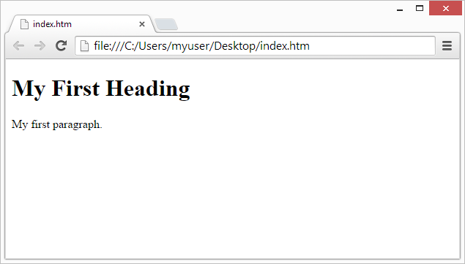
半岛中文学校 HTML Fundamentals
Web Browsers
The purpose of a web browser (Chrome, Edge, Firefox, Safari) is to read HTML documents and display them.
The browser does not display the HTML tags, but uses them to determine how to display the document:

Slide 6
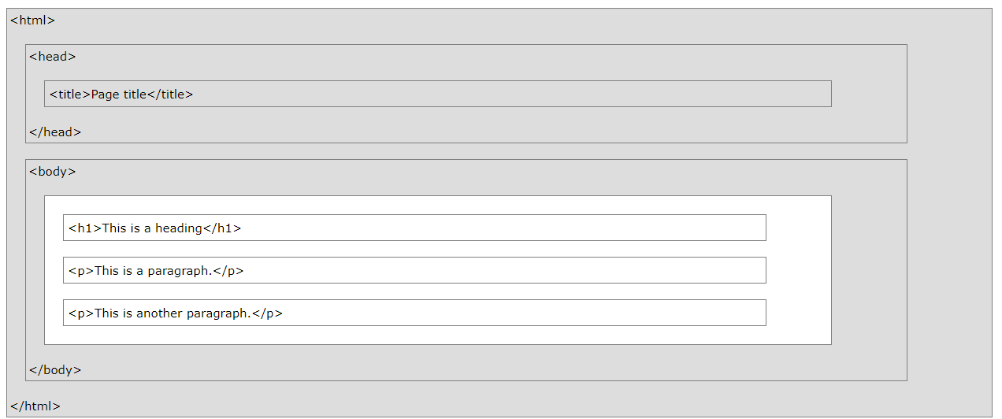
半岛中文学校 HTML Fundamentals
HTML Page Structure

Slide 7
半岛中文学校 HTML Fundamentals
HTML Editors
Notepad (PC) or TextEdit (Mac)
HTML Documents
All HTML documents must start with a document type declaration: <!DOCTYPE html>.
The HTML document itself begins with <html> and ends with </html>.
The visible part of the HTML document is between <body> and </body>.

Slide 8
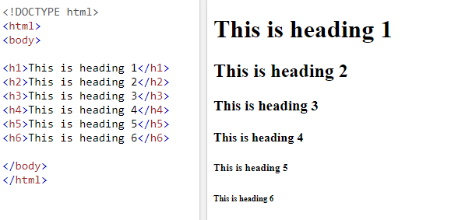
半岛中文学校 HTML Fundamentals
HTML Headings
HTML headings are defined with the <h1> to <h6> tags.
<h1> defines the most important heading. <h6> defines the least important heading:

Slide 9
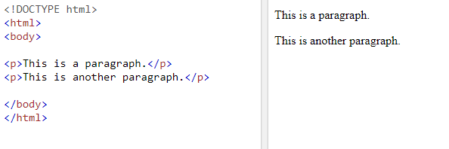
半岛中文学校 HTML Fundamentals
HTML Paragraphs
HTML paragraphs are defined with the <p> tag:
HTML Links
HTML links are defined with the <a> tag:

Slide 10
半岛中文学校 HTML Fundamentals
HTML Images
HTML paragraphs are defined with the <img> tag:
<img src=“StarWars.jpg" alt=“StarWars.com" width=“500" height=“500">
HTML Buttons
<button>Click me</button>
HTML Lists
HTML lists are defined with the <ul> (unordered/bullet list)
or the <ol> (ordered/numbered list) tag, followed by <li> tags (list items):

